Slide 1
FCL Capital
2025
Institutional presentation
© 2025 FCL Capital Presentation. All rights reserved.

Slide 2
Summary
About us
Positions & strategies
Performance
Portfolio
Operations
Our partners
Contact and Q&A
© 2025 FCL Capital Presentation. All rights reserved.

Slide 3
About us
Why do we exist?
We attempt to fill a void: a global investment approach by a team based in a different geography, with a different perspective and a “boots on the ground” philosophy.
The open space we tried to fill when we launched → tremendous intellectual power in the global investment industry, but relatively little emphasis in our three pillars:
© 2025 FCL Capital Presentation. All rights reserved.

Slide 4
1 Truly global mindset
© 2025 FCL Capital Presentation. All rights reserved.

Slide 5
2 Belief that the best ideas are on the uncovered and unconventional places
© 2025 FCL Capital Presentation. All rights reserved.

Slide 6
3 Contrarian and daring attitude with disregard for institutional constrains
© 2025 FCL Capital Presentation. All rights reserved.

Slide 7
About us
A different take on some of our well-known investment cases
© 2025 FCL Capital Presentation. All rights reserved.

Slide 8
About us
Our philosophy
FCL Capital is a long term oriented, value focused investment company in search for unconventional and asymmetric long term investment opportunities with an eye on the big 21st century technological and societal trends. We are proud to have a contrarian attitude and a portfolio with little correlation with most other funds and global investment vehicles.
© 2025 FCL Capital Presentation. All rights reserved.

Slide 9
About us
Investment framework
In our eternal search for inefficiencies, we uncover investment edges in the overlooked corners of finance, like:
Misunderstood companies, often located in emerging markets where we believe we have an edge
Investments in new technologies that bring new habits and paradigm shifts
Relatively illiquid and overlooked assets
Longer term ideas and time horizon than the market average
© 2025 FCL Capital Presentation. All rights reserved.

Slide 10
About us
Our investment beliefs
Conviction and concentration → Willingness to bet in a portfolio of a few specific big impact ideas
Intersection between private equity and public markets
Global portfolio, with an emphasis in G7 companies with a significative presence in emerging markets as well as misunderstood emerging market companies with the potential to become global 21st century champions
Long term value framework and fundamental analysis with an independent mindset and willingness to bet against consensus
Focus in non-obvious and neglected opportunities. We search for alpha in overlooked corners of finance and business
© 2025 FCL Capital Presentation. All rights reserved.

Slide 11
Summary
About us
Positions & strategies
Performance
Portfolio
Operations
Our partners
Contact and Q&A
© 2025 FCL Capital Presentation. All rights reserved.

Slide 12
Positions & strategies
Our top-down thesis
European luxury
Chinese consumption
Energy transition
The fashion world’s equivalent of the FAANGS
Tech disruption
Overlooked EM companies
© 2025 FCL Capital Presentation. All rights reserved.

Slide 13
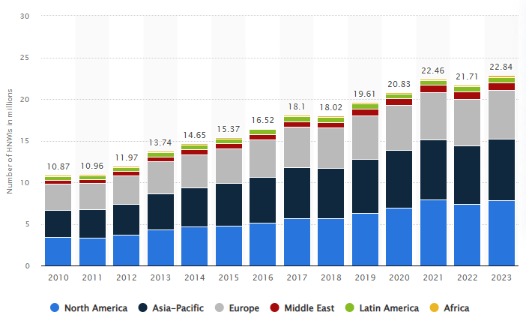
Positions & strategies
European luxury
A wealthier and more unequal world will particularly benefit luxury
*
Source: Statista
*HNWI (High Net Worth Individual) – a person with a net worth of at least USD 1 million.
© 2025 FCL Capital Presentation. All rights reserved.

Slide 14
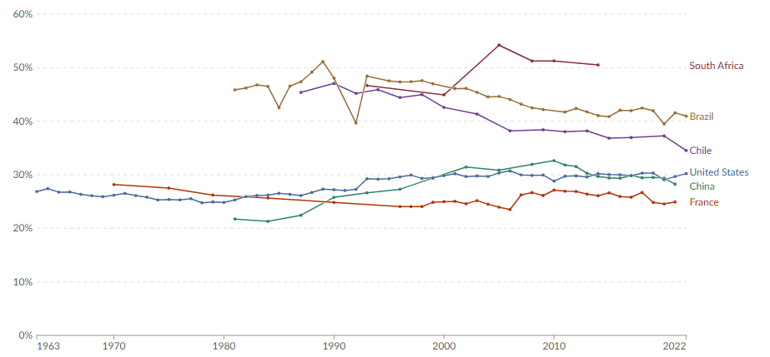
Positions & strategies
European luxury
A wealthier and more unequal world will particularly benefit luxury
Income or consumption share of the richest 10%
Source: Our World In Data
© 2025 FCL Capital Presentation. All rights reserved.

Slide 15
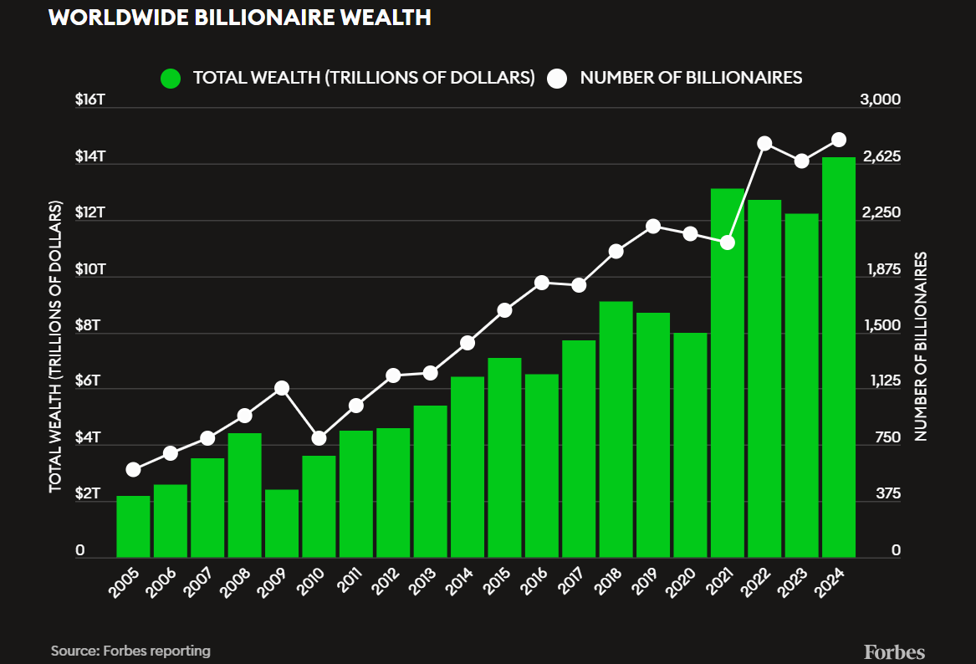
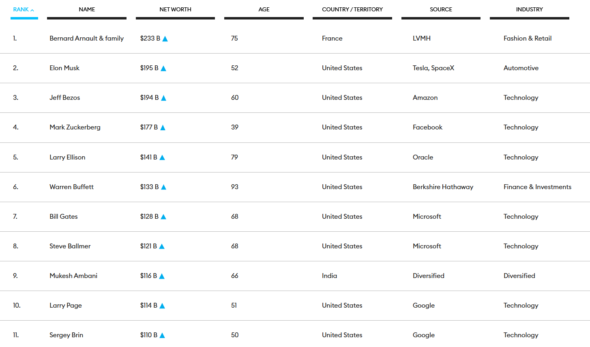
Positions & strategies
European luxury
A wealthier and more unequal world will particularly benefit luxury
Source: Forbes reporting (date 02/18/2025)
© 2025 FCL Capital Presentation. All rights reserved.

Slide 16
Positions & strategies
European luxury
Examples of our previous and current investments
© 2025 FCL Capital Presentation. All rights reserved.

Slide 17
Positions & strategies
European luxury
Overview of our investment in Moncler
Position started – 11/11/2019 – €37.20
Today – 01/31/2025 – €61.28
© 2025 FCL Capital Presentation. All rights reserved.

Slide 18
Positions & strategies
Our top-down thesis
European luxury
Chinese consumption
Energy transition
A new world order brought by tech
Tech disruption
Overlooked EM companies
© 2025 FCL Capital Presentation. All rights reserved.

Slide 19
Positions & strategies
Tech disruption
Physical world in decline → virtual world rising
Digital “native” generation
Global, as opposed to California based, opportunities
© 2025 FCL Capital Presentation. All rights reserved.

Slide 20
Positions & strategies
Tech disruption
We were able to notice early the inflection point in this Era defining company while it was still overlooked by the market thanks to our privileged position in Brazil
Source: Uber website
Source: Uber website
Source: Uber website
© 2025 FCL Capital Presentation. All rights reserved.

Slide 21
Positions & strategies
Tech disruption
Era defining company that we caught in the middle of a free cash flow inflection point that was for years overlooked by the market. Sell side considered international revenue an afterthought
© 2025 FCL Capital Presentation. All rights reserved.

Slide 22
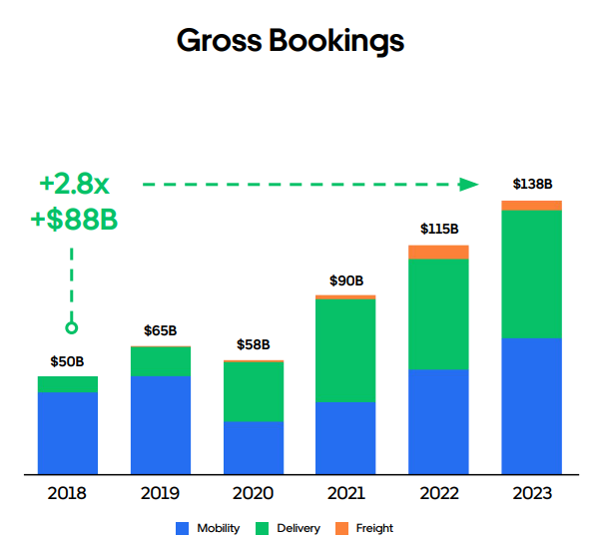
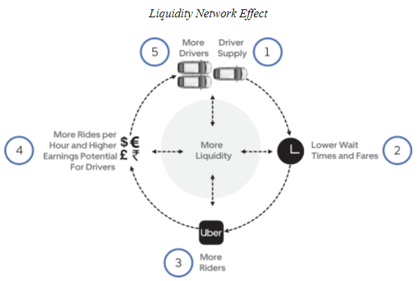
Positions & strategies
Tech disruption
Era defining company that we caught in the middle of a free cash flow inflection point that was for years overlooked by the market. Sell side considered international revenue an afterthought
© 2025 FCL Capital Presentation. All rights reserved.

Slide 23
Positions & strategies
Tech disruption
“Success in Mobility starts with drivers, the engine of growth” as stated in Uber investor day 2024
Trips: 1,550 millions to 3,068 millions
Position sold – 12/01/2025 – US$66.29
Trips
Stock price
Position started – 02/08/2022 – US$43.49
US$ 60.32
US$ 29.74
© 2025 FCL Capital Presentation. All rights reserved.

Slide 24
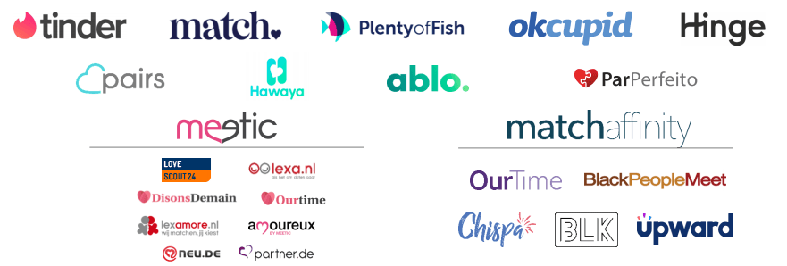
Positions & strategies
Tech disruption
Our position in Brazil and our global travels allowed us to see before sell side based in NYC that Tinder was a global phenomenon
Source: Match Group Investor Presentation
© 2025 FCL Capital Presentation. All rights reserved.

Slide 25
Positions & strategies
Tech disruption
Our position in Brazil and our global travels allowed us to see before sell side based in NYC that Tinder was a global phenomenon
Source: Match Group Investor Presentation
*All in million USD
© 2025 FCL Capital Presentation. All rights reserved.

Slide 26
Positions & strategies
Tech disruption
Our position in Brazil and our global travels allowed us to see before sell side based in NYC that Tinder was a global phenomenon
Position started – 03/15/2017 – US$ 19.00
Position sold – 05/09/2020 – US$ 97.00
US$ 170.00
US$ 30.00
US$ 20.00
Source: Match Group Investor Presentation
© 2025 FCL Capital Presentation. All rights reserved.

Slide 27
Positions & strategies
Our top-down thesis
European luxury
Chinese consumption
Energy transition
Asian consumption will change the 21st century
Tech disruption
Overlooked EM companies
© 2025 FCL Capital Presentation. All rights reserved.

Slide 28
Positions & strategies
Chinese consumption
Chinese consumption is still 40% of its GDP vs. 70% in the US. If we assume that today’s Chinese economy is three quarters of the US’s size, China’s consumption can easily multiply by 3X or 4X in the next 20 years
© 2025 FCL Capital Presentation. All rights reserved.

Slide 29
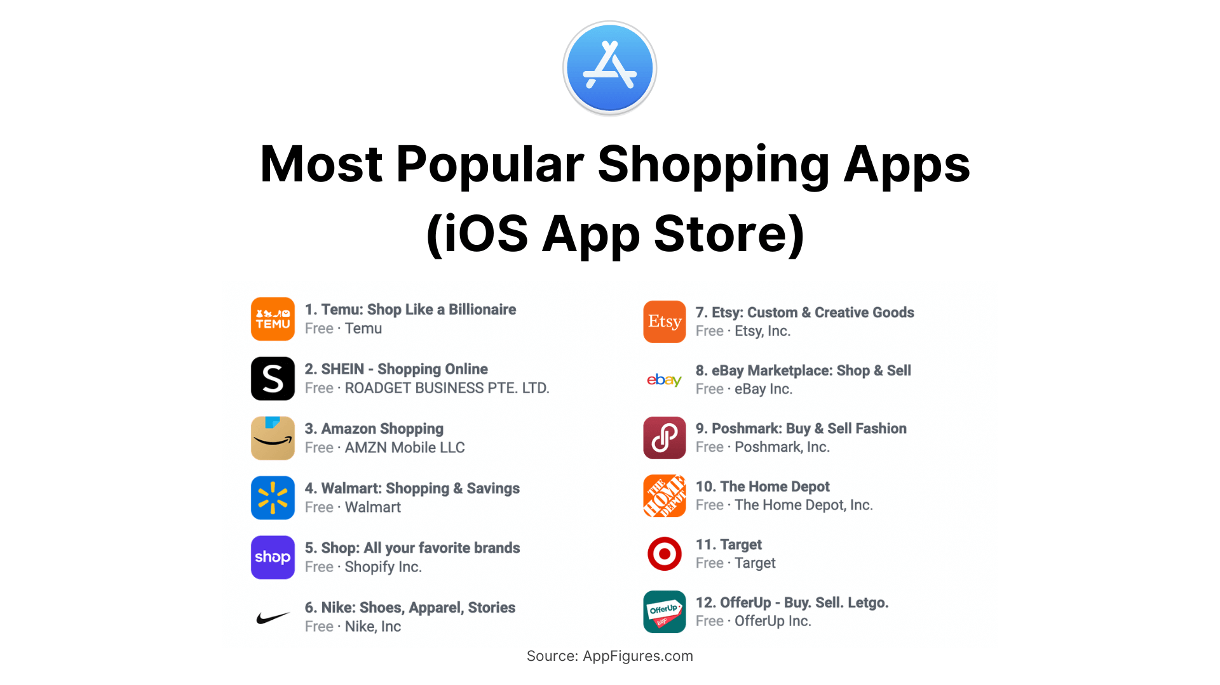
Positions & strategies
Chinese consumption
Over time, as the Chinese population further urbanizes and increase their consumption, the leaders in the country’s e-commerce space are likely to have a bright future
US$ 34,950.00 B
51.6% CAGRyear
US$ 8,470.00 B
53.0% CAGRyear
US$ 4,360.00 B
US$ (1,010.00) B
© 2025 FCL Capital Presentation. All rights reserved.

Slide 30
Positions & strategies
Chinese consumption
Over time, as the Chinese population further urbanizes and increase their consumption, the leaders in the country’s e-commerce space are likely to have a bright future
Position started – 12/01/2022 – US$ 96.40
Today – 01/31/2025– US$ 111.91
US$ 202.82
US$ 24.60
US$ 4,360.00 B
US$ (1,010.00) B
© 2025 FCL Capital Presentation. All rights reserved.

Slide 31
Positions & strategies
Our top-down thesis
European luxury
Chinese consumption
Energy transition
Misunderstood, overlooked and underfollowed companies
Tech disruption
Overlooked EM companies
© 2025 FCL Capital Presentation. All rights reserved.

Slide 32
Positions & strategies
Overlooked EM companies
We believe that massive investment opportunities come from the neglected and overlooked corners of the market. FCL Capital usually refer to these companies as misunderstood companies
© 2025 FCL Capital Presentation. All rights reserved.

Slide 33
Positions & strategies
Overlooked EM companies
We believe that massive investment opportunities come from the neglected and overlooked corners of the market. FCL Capital usually refer to these companies as misunderstood companies
Position started – 08/13/2015 – US$10.00
Position ended – 03/22/2018 – US$15.72
© 2025 FCL Capital Presentation. All rights reserved.

Slide 34
Positions & strategies
Our top-down thesis
European luxury
Chinese consumption
Energy transition
One of the main long-term challenges we face as a society
Tech disruption
Overlooked EM companies
© 2025 FCL Capital Presentation. All rights reserved.

Slide 35
Positions & strategies
Energy transition
We are witnessing the birth of mankind’s largest investment campaign: to change its energy matrix and its environmental processes
© 2025 FCL Capital Presentation. All rights reserved.

Slide 36
Positions & strategies
Energy transition
Chinese leader that will popularize electric and hybrid vehicles around the world, for the many and not only for the few
*All in million RMB
© 2025 FCL Capital Presentation. All rights reserved.

Slide 37
Positions & strategies
Energy transition
Chinese leader that will popularize electric and hybrid vehicles around the world, for the many and not only for the few
RMB 331.40
RMB 273.00
RMB 42.95
© 2025 FCL Capital Presentation. All rights reserved.

Slide 38
Summary
About us
Positions & strategies
Performance
Portfolio
Operations
Our partners
Contact and Q&A
© 2025 FCL Capital Presentation. All rights reserved.

Slide 39
Performance
FCL Opportunities versus Global Equities Indexes since our inception
+168%
+117%
+103%
+98%
+20%
+7%
© 2025 FCL Capital Presentation. All rights reserved.

Slide 40
Performance
FCL Opportunities versus MSCI All Country Index since our inception
+168%
+117%
+103%
+98%
+20%
+7%
© 2025 FCL Capital Presentation. All rights reserved.

Slide 41
Performance
FCL Opportunities versus Brazilian benchmarks since our inception
+117%
+98%
+61.78%
© 2025 FCL Capital Presentation. All rights reserved.

Slide 42
Performance
Ups and downs through the cycles: pre-pandemic performance
January 30th, 2020 – NAV: BRL 1.95
March 30th, 2020 – NAV: BRL 1.67
+168%
+117%
+103%
+98%
+20%
+7%
© 2025 FCL Capital Presentation. All rights reserved.

Slide 43
Performance
Ups and downs through the cycles: market sell-off
January 30th, 2022 – NAV: BRL 2.47
March 31st, 2023 – NAV: BRL 2.08
+168%
+117%
+103%
+98%
+20%
+7%
© 2025 FCL Capital Presentation. All rights reserved.

Slide 44
Performance
S&P 500 versus Emerging Markets Index
+168%
+117%
+103%
+98%
+20%
+7%
© 2025 FCL Capital Presentation. All rights reserved.

Slide 45
Performance
Performance attribution – Since inception
Top 2 contributors:
Top 2 detractors:
© 2025 FCL Capital Presentation. All rights reserved.

Slide 46
Performance
Performance attribution – 2024
Top 2 contributors:
Top 2 detractors:
© 2025 FCL Capital Presentation. All rights reserved.

Slide 47
Performance
Performance attribution – Since inception
Top 2 contributors:
Top 2 detractors:
United States
China
Europe
Africa
© 2025 FCL Capital Presentation. All rights reserved.

Slide 48
Performance
Stock picking was able to mitigate our exposure disadvantage
© 2025 FCL Capital Presentation. All rights reserved.

Slide 49
Performance
Stock picking was able to mitigate our exposure disadvantage
© 2025 FCL Capital Presentation. All rights reserved.

Slide 50
Performance
Stock Markets versus Bond Markets
© 2025 FCL Capital Presentation. All rights reserved.

Slide 51
Summary
About us
Positions & strategies
Performance
Portfolio
Operations
Our partners
Contact and Q&A
© 2025 FCL Capital Presentation. All rights reserved.

Slide 52
Portfolio
FCL Opportunities portfolio snapshot
On January 31st , 2025
© 2025 FCL Capital Presentation. All rights reserved.

Slide 53
Portfolio
FCL Opportunities portfolio snapshot
On January 31st , 2025
© 2025 FCL Capital Presentation. All rights reserved.

Slide 54
Portfolio
FCL Opportunities portfolio snapshot
On January 31st , 2025
© 2025 FCL Capital Presentation. All rights reserved.

Slide 55
Portfolio
FCL Opportunities portfolio snapshot
On January 31st , 2025
© 2025 FCL Capital Presentation. All rights reserved.

Slide 56
Portfolio
FCL Opportunities portfolio snapshot
Top 5 positions through the years
© 2025 FCL Capital Presentation. All rights reserved.

Slide 57
Portfolio
FCL Opportunities portfolio snapshot
This low turnover and longer-term focus is supported by our investors
*Redemption as a % of NAV
© 2025 FCL Capital Presentation. All rights reserved.

Slide 58
Portfolio
FCL Opportunities portfolio snapshot
Emerging Markets x Developed Markets portfolio exposure
52.9%
52.7%
37.5%
47.3%
2017
2025
© 2025 FCL Capital Presentation. All rights reserved.

Slide 59
Portfolio
FCL Opportunities portfolio snapshot
Our aggregate portfolio on January 31st , 2025
© 2025 FCL Capital Presentation. All rights reserved.

Slide 60
Summary
About us
Positions & strategies
Performance
Portfolio
Operations
Our partners
Contact and Q&A
© 2025 FCL Capital Presentation. All rights reserved.

Slide 61
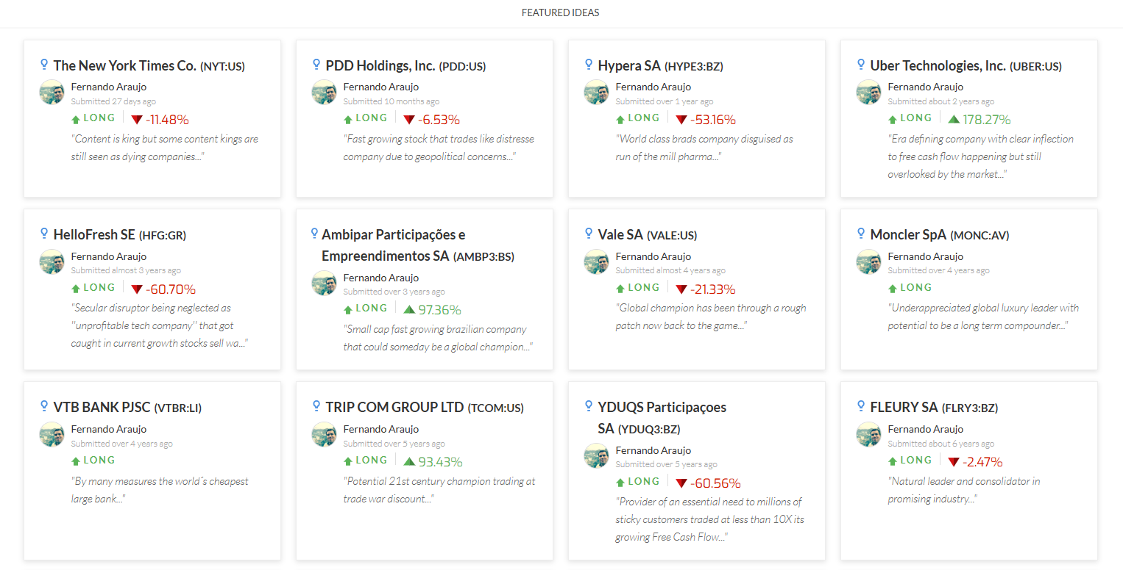
Operations
Active SumZero research ideas
© 2025 FCL Capital Presentation. All rights reserved.

Slide 62
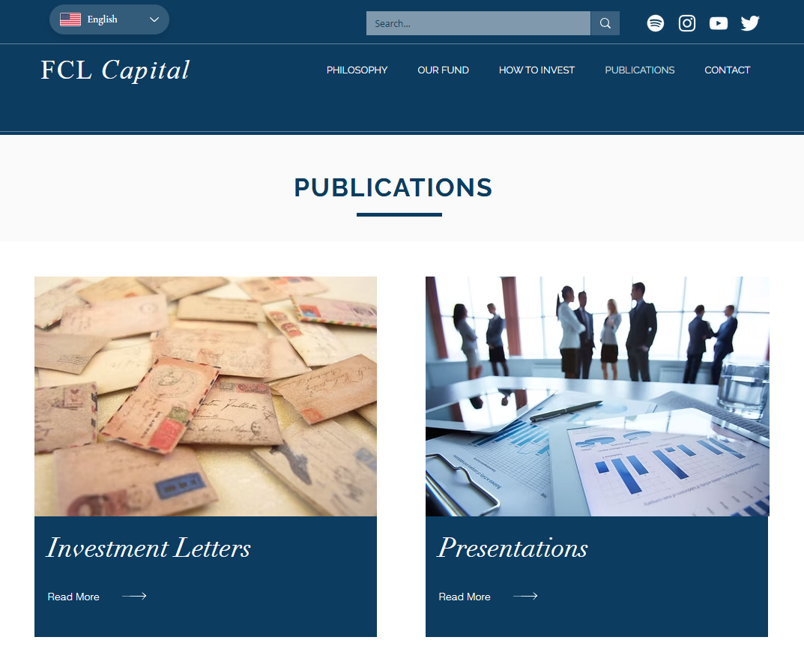
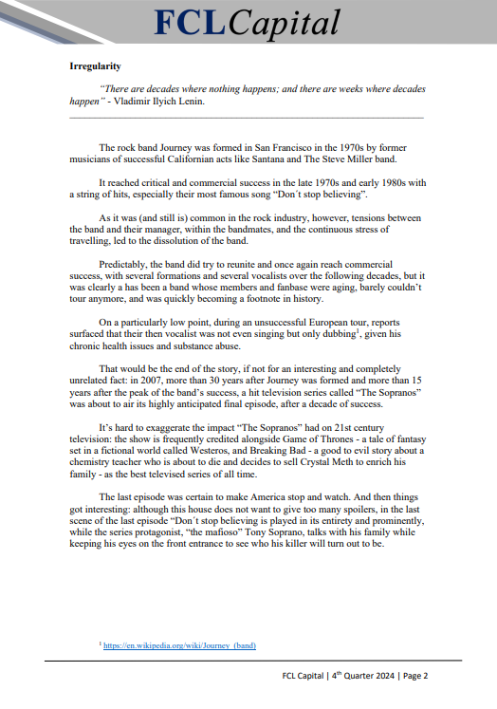
Operations
Our famous quarterly letters which are always available at our website
© 2025 FCL Capital Presentation. All rights reserved.

Slide 63
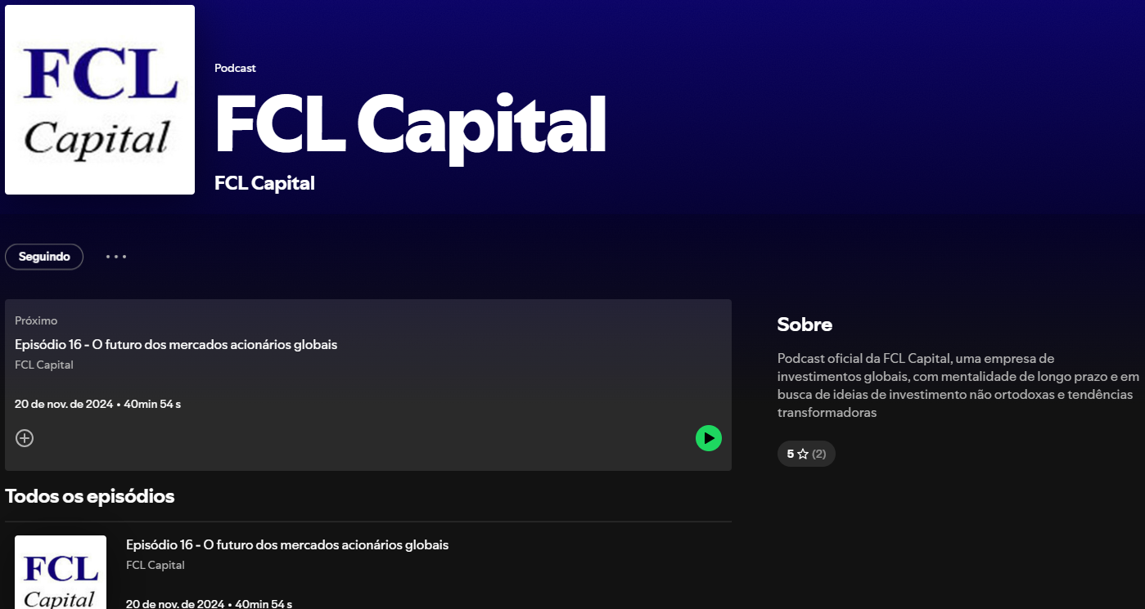
Operations
Our podcast - a democratic and alternative way of communicating with our investors
© 2025 FCL Capital Presentation. All rights reserved.

Slide 64
Operations
Media appearances – Stock Pickers official podcast
© 2025 FCL Capital Presentation. All rights reserved.

Slide 65
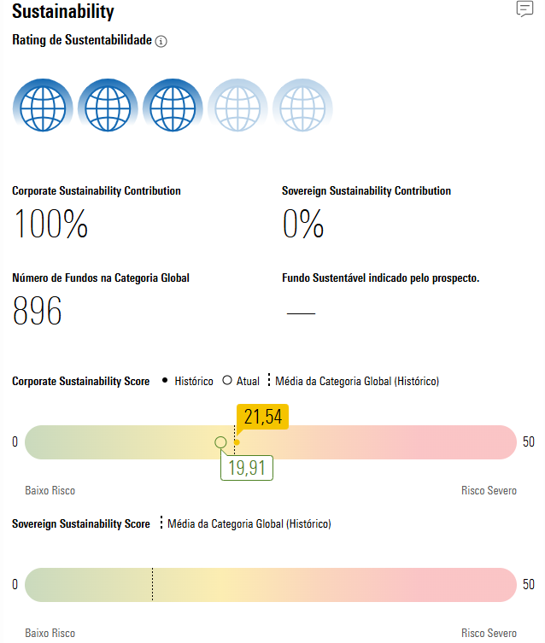
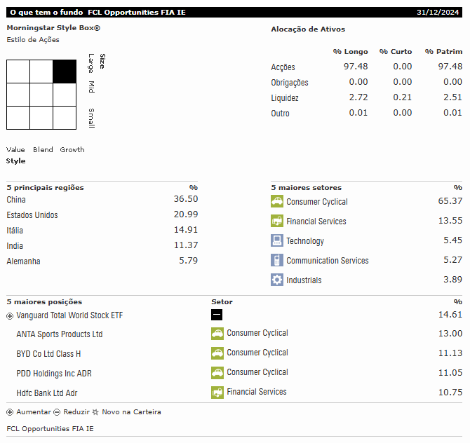
Operations
Morningstar
© 2025 FCL Capital Presentation. All rights reserved.

Slide 66
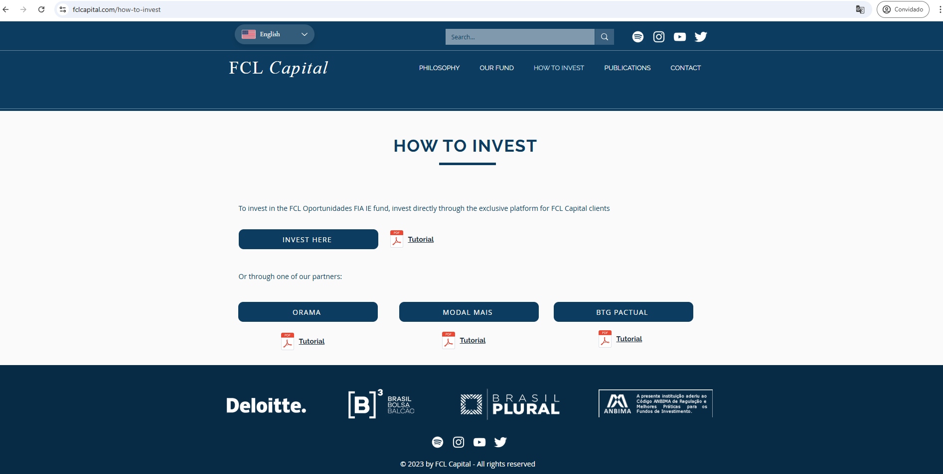
Operations
How to invest
We have a special area in our website, but you can contact us on info@fclcapital.com
© 2025 FCL Capital Presentation. All rights reserved.

Slide 67
Summary
About us
Positions & strategies
Performance
Portfolio
Operations
Our partners
Contact and Q&A
© 2025 FCL Capital Presentation. All rights reserved.

Slide 68
Partners
We would like to give a special thanks to all our partners that help make our work possible
Administration
Custody
Auditing
Distribution
© 2025 FCL Capital Presentation. All rights reserved.

Slide 69
Summary
About us
Positions & strategies
Performance
Portfolio
Operations
Our partners
Contact and Q&A
© 2025 FCL Capital Presentation. All rights reserved.

Slide 70
Contact and Q&A
Thank you all for your time!
Contacts:
+55 21 99156 7642
+55 21 99467 1174
info@fclcapital.com
www.fclcapital.com
© 2025 FCL Capital Presentation. All rights reserved.

